Slide 1
Statistical and Predictive Modeling Assignment 5- Linear Regression Name of the Student: Maisha Khatoon Student ID: 100899259

Slide 2
Description of the Analysis
Overview: Simple Linear Regression Analysis seeks to create a linear correlation between two variables, with one variable serving as the predictor (independent variable) and the other as the responder (dependent variable).
Introduction to Simple Linear Regression Analysis: This analysis examines the impact of "sex" on "expenses" using the Expenses.csv dataset. The predictor variable, "sex," denotes the biological classification of individuals based on their reproductive characteristics. The dependent variable, "expenses," represents the total amount of costs that have been accumulated.
Detailed examination: File: Expenses.csv, Independent Variable: "sex“, Dependent Variable: "expenses“.
Using Simple Linear Regression, we will establish a mathematical model to represent the correlation between gender and expenses. The significance of the relationship will be assessed via hypothesis testing. The analysis will be thoroughly explored to provide a comprehensive grasp of the insights acquired.

Slide 3
Steps for Hypothesis Testing
1. Formulating Hypotheses:
The null hypothesis (H_{o}) states that there is no statistically significant association between an individual's sex and their expenses.
The alternative hypothesis (H₁) states that there exists a statistically meaningful correlation between an individual's gender and their expenditures.
Validating the assumptions of linearity, independence, constant variance, and normality.
The significance level, typically set at 0.05, indicated as α, is the chance of rejecting the null hypothesis when it is true.
2. Assumptions Verification for Linear Regression Model:
Before performing hypothesis testing, it is crucial to verify that the assumptions of linear regression are satisfied.
The assumptions for this analysis are that the data follows a linear pattern, the observations are independent, the residuals have a constant variance (homoscedasticity), and the residuals are normally distributed.

Slide 4
Conduction of the Simple Linear Regression Analysis
Process of Analysis:
Import and display dataset:
Use the R programming language to load the Expenses.csv dataset.
Analyze the arrangement and information within the dataset by using the str() function.
2. Create a linear model:
Utilize the lm() method to build a linear model.
Specify the regression formula as follows: expenses ~ sex, where expenses are the dependent variable and sex is the predictor variable.
3. Overview of Important Metrics:
Use the summary() method to acquire essential statistics of the linear model.
Analyze the coefficients, standard errors, t-values, p-values, and R-squared.

Slide 5
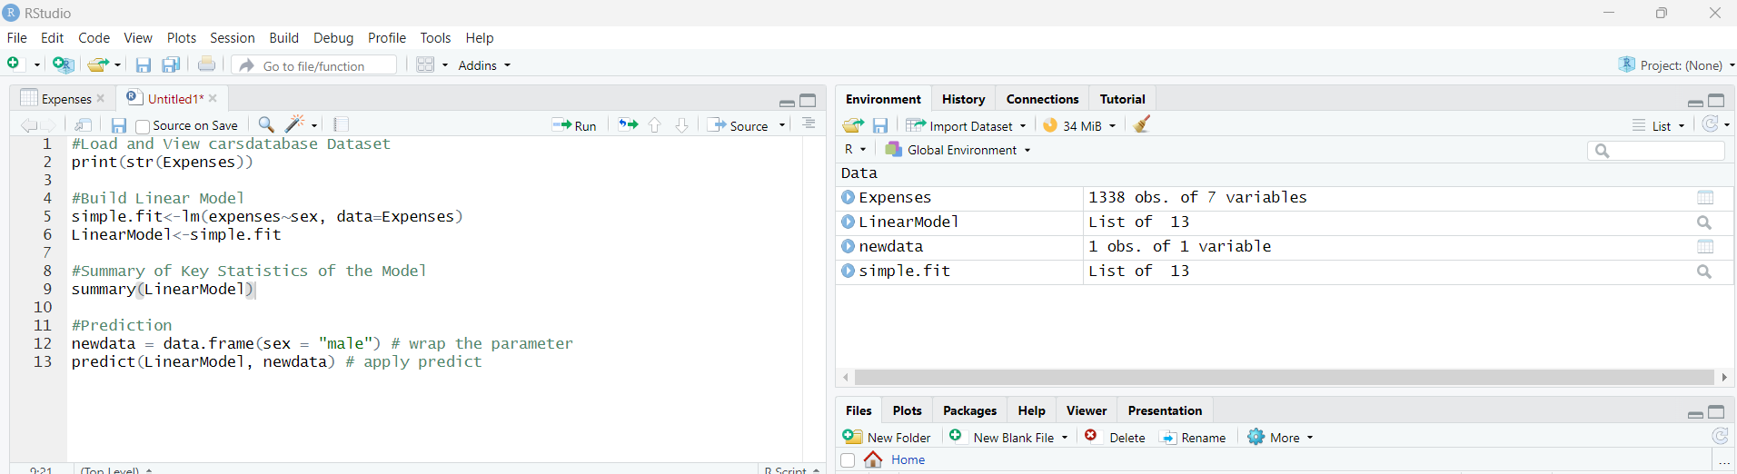
The R Code for the Analysis

Slide 6
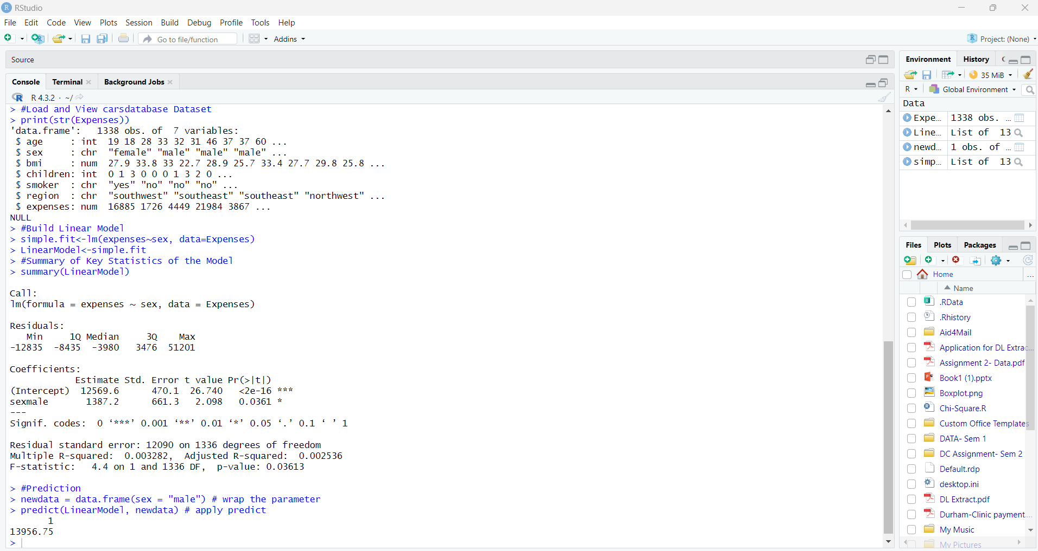
Linear Regression Test Results
Standard errors: 12090 on 1336 degrees of freedom
p-values: 0.03613
Multiple R-squared= 0.003282
Adjusted R-squared= 0.002536

Slide 7
Insights gained from the results
1. Influence of Gender on Expenditures: The equation obtained from the analysis is a linear regression model that predicts expenses (Y) based on the sex of the individual (X). The equation is Y = 12569.6 + (1387.2) * X. Analysis of the sex coefficient: The sex coefficient is 1387.2. This indicates that for each incremental change in the sex variable (e.g., transitioning from Female to Male), there is an average increase of 1387.2 units in expenses.
2. The p-value is a statistical measure that quantifies the significance of a hypothesis test. It represents the probability of obtaining the observed data, or more extreme data, on the assumption that the null hypothesis is true. A small p-value indicates strong. The p-value for the sex coefficient is 0.03613.
3. Comparison with the significance level (α = 0.05): The p-value is below the significance level, showing statistical significance. Thus, there is sufficient evidence to refute the null hypothesis, indicating that gender exerts a substantial impact on spending.
4. Gaining a comprehensive understanding of how gender influences expenditures offers significant information for a range of stakeholders, including marketers, policymakers, and enterprises.
5. Designing plans and initiatives that are customized according to the spending habits specific to each gender might result in a more efficient allocation of resources and focused marketing efforts.

Slide 8
Key findings based on the insights
Comprehending the spending patterns that are distinct to each gender offers useful data for marketers and enterprises.
Customizing marketing techniques and product offerings based on gender preferences can improve client engagement and satisfaction.
Policymakers can utilize these observations to develop gender-specific policies to foster economic empowerment and ensure financial inclusion.
Businesses can enhance resource allocation and marketing efforts by aligning tactics with consumer preferences depending on gender.
An in-depth investigation of the fundamental causes that contribute to gender differences in spending patterns.
Exploring supplementary variables such as age, income, and lifestyle characteristics to enhance comprehension and enhance the precision of predictive models.

Slide 9
Improvement of Model Accuracy (Additional Variable)
1. Level of education:
The amount of education can impact spending behavior by its influence on individuals' income potential, career decisions, and financial knowledge.
Increased degrees of education are often associated with higher salaries and distinct spending preferences, including allocating funds toward educational fees or discretionary acquisitions.
2. Marital Status:
The spending patterns of individuals might be influenced by their marital status as a result of shared financial obligations, home dynamics, and alterations in lifestyle.
Married individuals may distribute expenses in a different manner than single or divorced folks, which reflects their collaborative decision-making and financial strategizing.
By incorporating education level and marital status as supplementary predictor variables in the model, a more comprehensive understanding of the factors influencing spending behavior may be obtained, leading to improved prediction accuracy in the analysis.

Slide 10
Conclusion
According to the data, there is a considerable correlation between sex and expenses, with males having higher expenses. The statistical importance of this link is demonstrated by the regression analysis, which offers important insights into gender-specific spending habits.
The association between sex and expenses is statistically significant, but its real-world consequences might be more complex. The results point to a relationship between gender and spending patterns, but it is important to avoid drawing too many conclusions from them. To comprehend the underlying mechanisms guiding these spending patterns, more investigation is necessary.
Subsequent studies might investigate the other elements that affect costs in greater detail. Taking into account factors like age, income, or geography may provide a more thorough picture of the dynamics of spending. Furthermore, examining possible interrelationships among predictors may clarify intricate linkages and enhance predictive models.

